Slide 1

Gradient Descent Optimization Algorithms – NAdam
Presented By:
Safin Ahmmed
Roll: 2307563 Dept. of Computer Science and Engineering Khulna University of Engineering & Technology

Slide 2
Outline
Introduction
Optimization algorithms
Stochastic gradient descent
SGD with Momentum
Nesterov Accelerated Gradient (NAG)
AdaGrad
RMSProp
Adam
NAdam

Slide 3
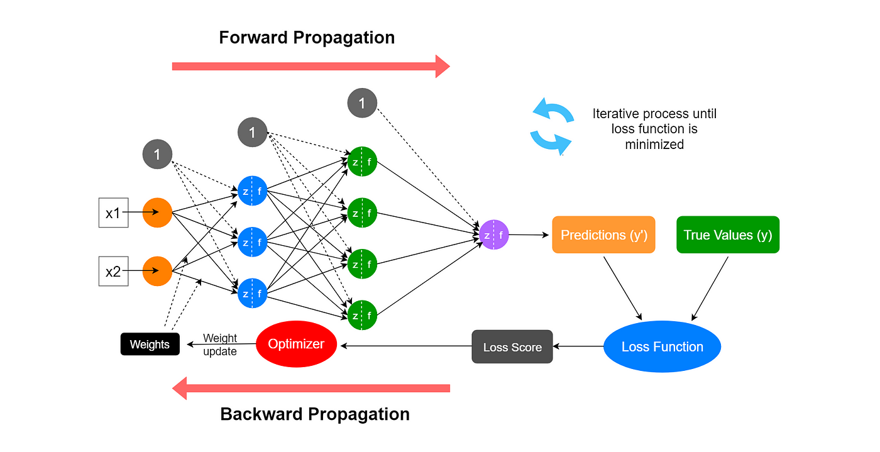
Introduction
Neural Network:

Slide 4
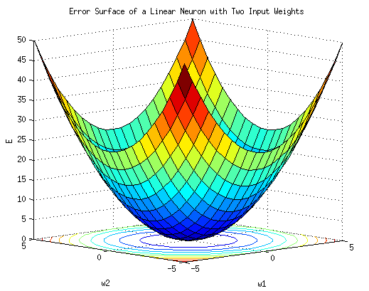
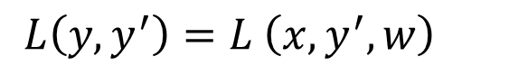
Introduction
Loss function:
$L\left(y,y^{′}\right)=L \left(x,y^{′},w\right)$

Slide 5
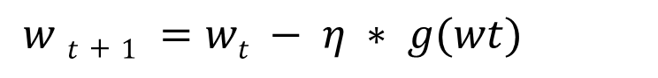
Gradient descent
Gradient descent :
Here, the choice of choice of learning rate 𝜂 is critical.
If 𝜂 is too small, may converge very slowly.
If it is too large, it may oscillate around the minimum or even diverge.
$w t+1 =wt − η ∗ g(wt)$

Slide 6
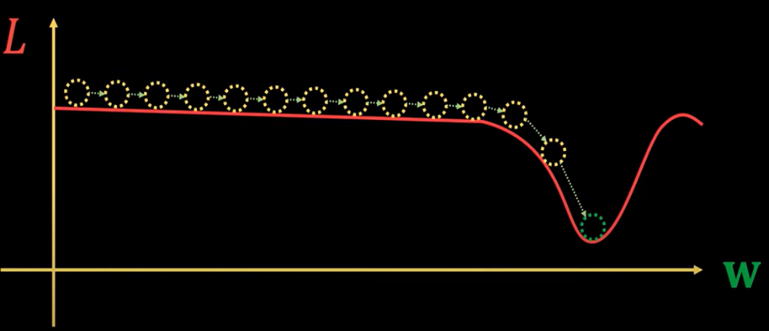
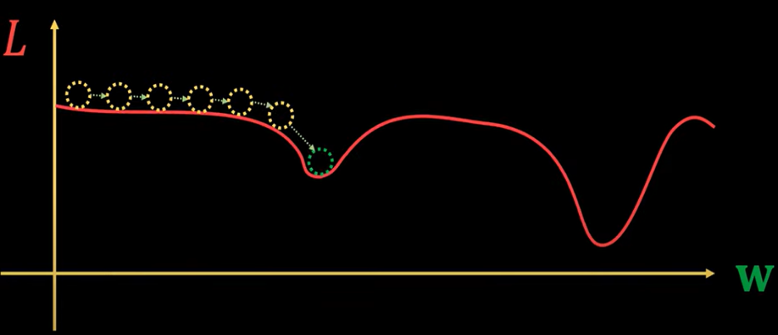
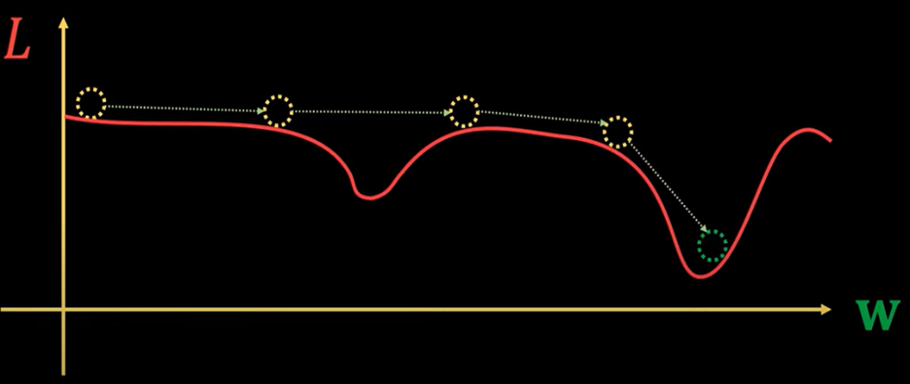
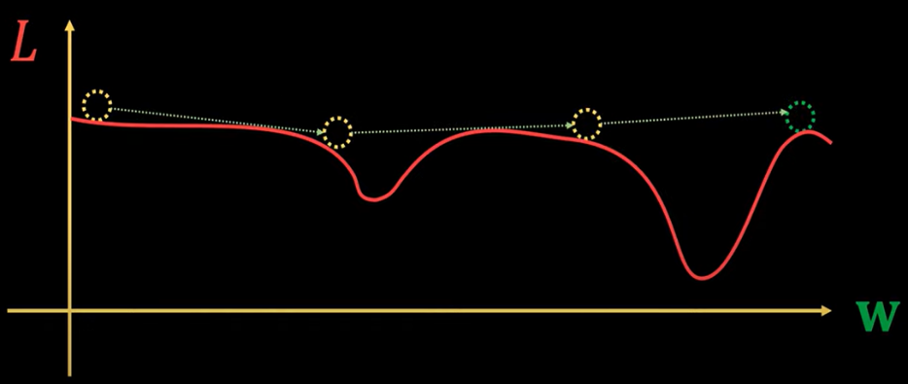
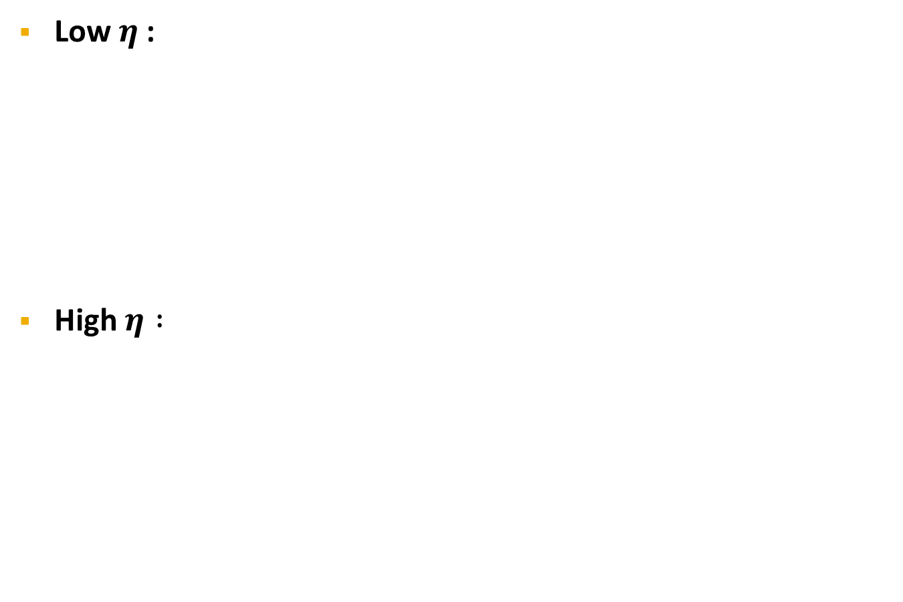
Gradient descent
Low $η$:
High $η :$

Slide 7
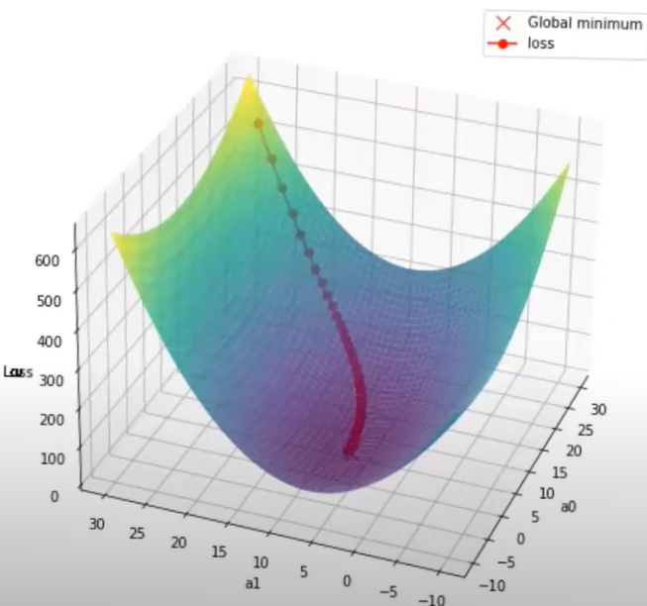
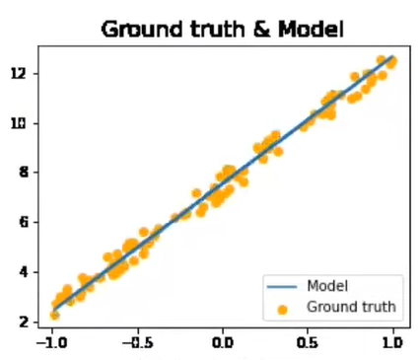
Batch Gradient descent
Computes gradients of the loss function for the entire training dataset.

Slide 8
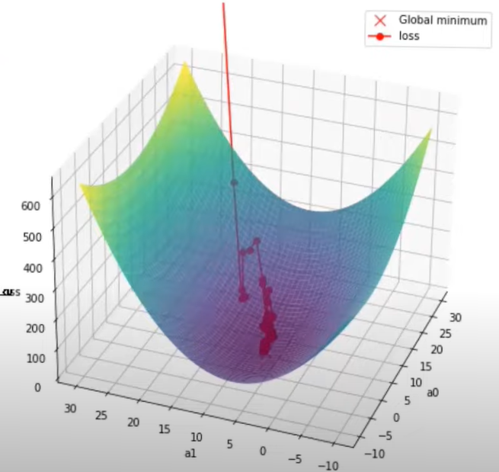
Stochastic Gradient descent
Performs a parameter update for each training example.

Slide 9
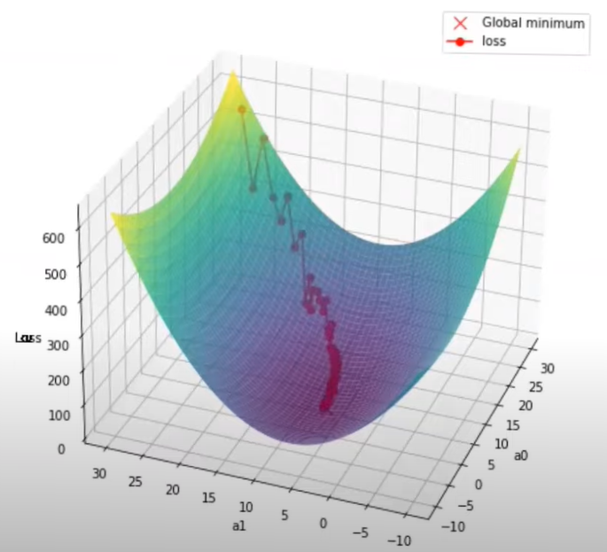
Mini-batch Gradient descent
performs an update for every mini-batch of n training examples.

Slide 10
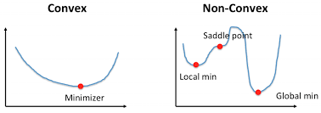
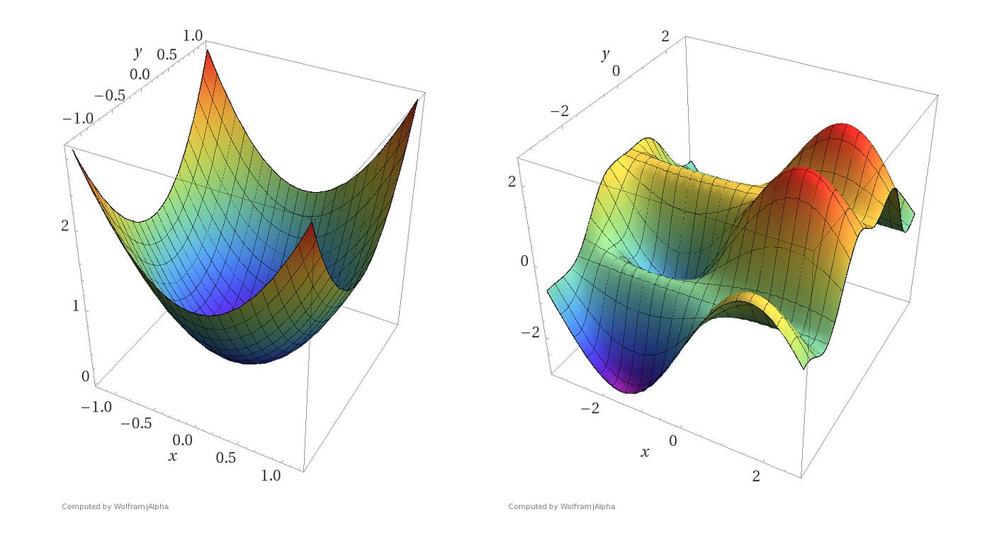
SGD with Momentum
Convex vs Non Convex optimization :

Slide 11
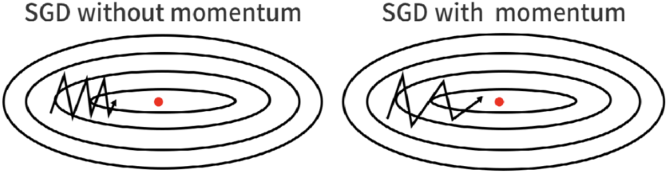
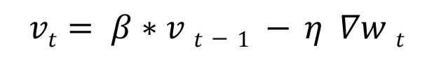
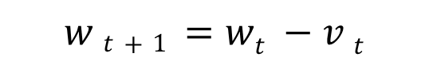
SGD with Momentum
introduces a momentum term to the parameter update step to help accelerate convergence and dampen oscillations.
Weight update:
$$w t+1 =wt −v t$$
$$vt= β∗v t−1 − η ∇w t$$

Slide 12
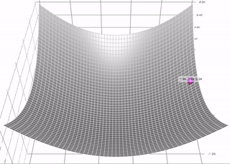
SGD with Momentum
Effect of beta :

Slide 13
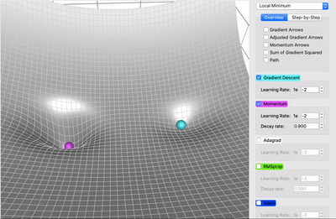
SGD with Momentum
Momentum vs SGD :

Slide 14
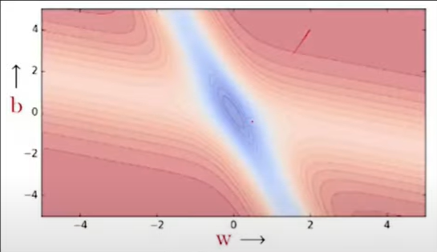
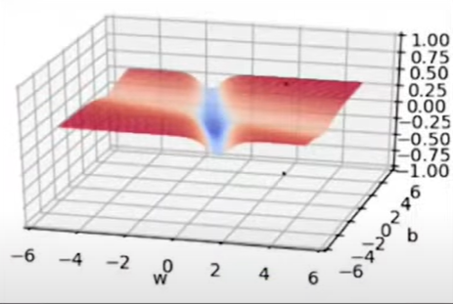
SGD with Momentum
Problem with momentum optimization :

Slide 15
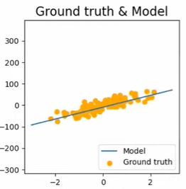
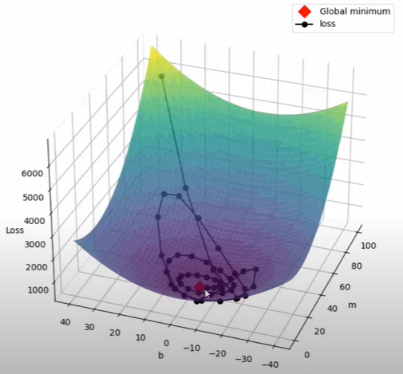
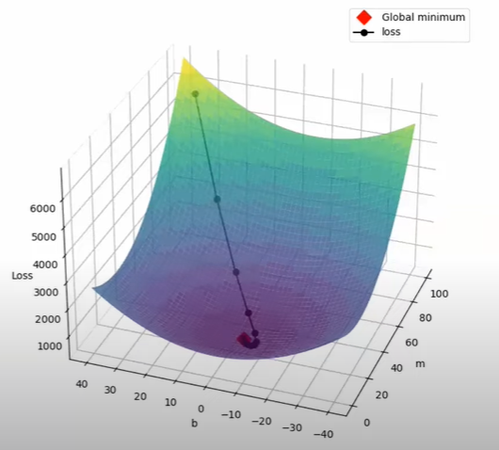
NAG
Problem with momentum optimization :

Slide 16
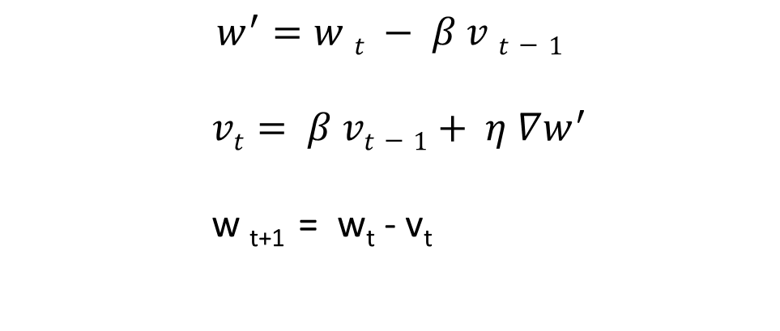
NAG
Weight update:
$$w^{′}=w t − β v t−1$$
$vt= β vt−1+ η ∇w^{′}$
w _{t+1} = w_{t} - v_{t}

Slide 17
NAG
Disadvantage:
Oscillation.
Local mimina.

Slide 18
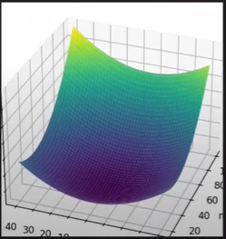
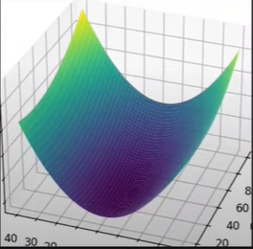
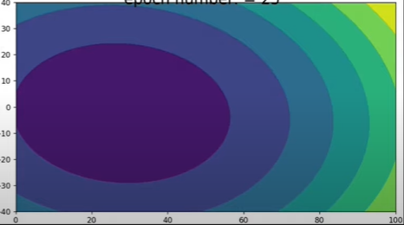
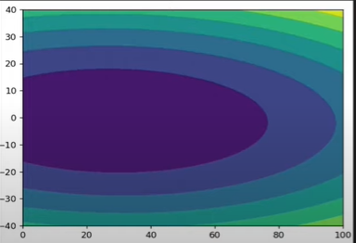
AdaGrad
Change learning rate with time.
Suitable for sparse data.
Address Elongated bowl problem.

Slide 19
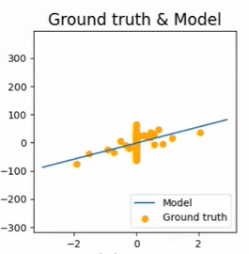
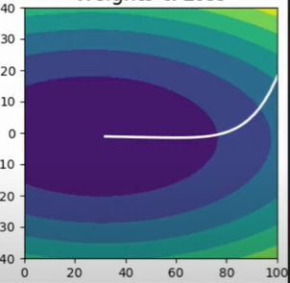
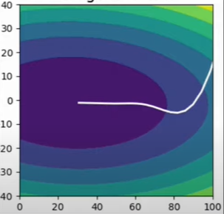
AdaGrad
How other optimizers behave:

Slide 20
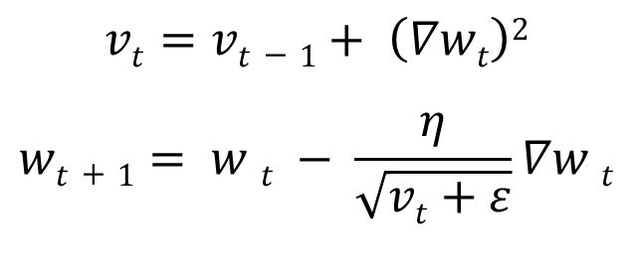
AdaGrad
Weight update:
$$vt=vt−1+ \left(∇wt\right)2$$
$$wt+1= w t − \frac{η}{\sqrt{vt+ε}}∇w t$$

Slide 21
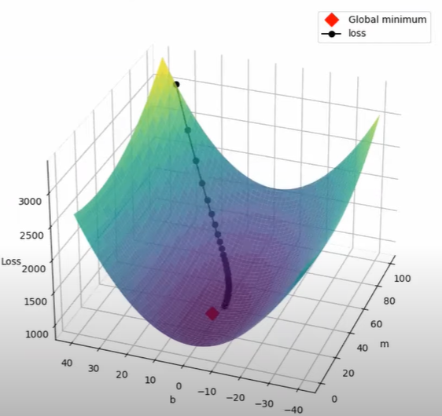
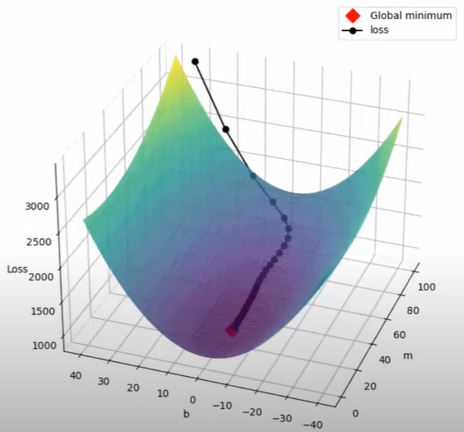
AdaGrad
AdaGrad vs Momentum:

Slide 22
AdaGrad
Disadvantage:

Slide 23
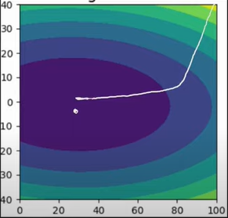
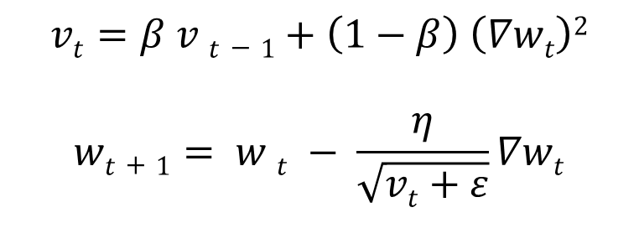
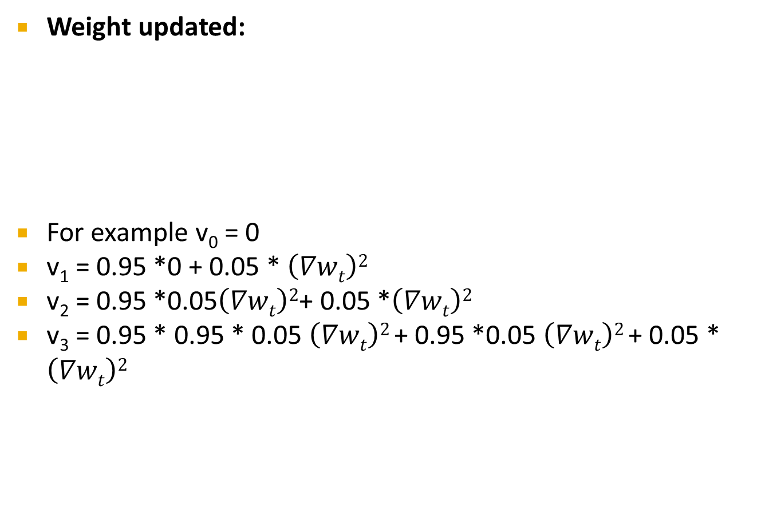
RmSProb
Weight updated:
For example v₀ = 0
v₁ = 0.95 *0 + 0.05 * $\left(∇wt\right)2$
v₂ = 0.95 *0.05$\left(∇wt\right)2$+ 0.05 *$\left(∇wt\right)2$
v₃ = 0.95 * 0.95 * 0.05 $\left(∇wt\right)2$+ 0.95 *0.05 $\left(∇wt\right)2$+ 0.05 * $\left(∇wt\right)2$
$$vt=β v t−1+\left(1−β\right) \left(∇wt\right)2$$
$$wt+1= w t − \frac{η}{\sqrt{vt+ε}}∇wt$$

Slide 24
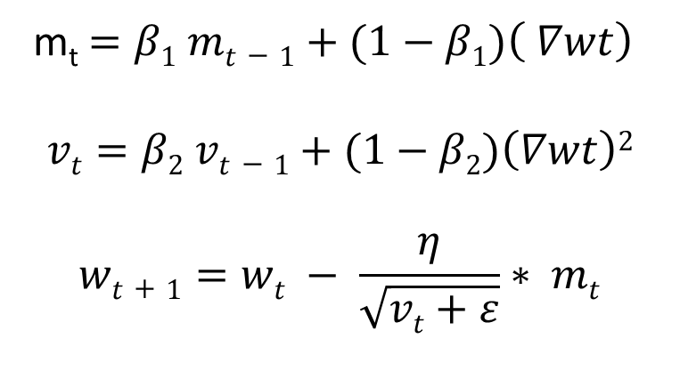
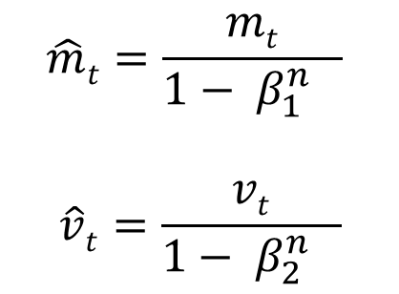
Adam
Weight updated:
Bias Correction:
m_{t}$=β1 mt−1+(1−β1)\left( ∇wt\right)$
$$vt=β2 vt−1+(1−β2)\left(∇wt\right)2$$
$$wt+1=wt − \frac{η}{\sqrt{vt+ε}}∗ mt$$
$$\hat{m}t=\frac{mt}{1− β_{1}^{n} }$$
$$\hat{v}t=\frac{vt}{1− β_{2}^{n} }$$

Slide 25
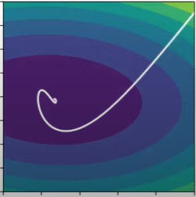
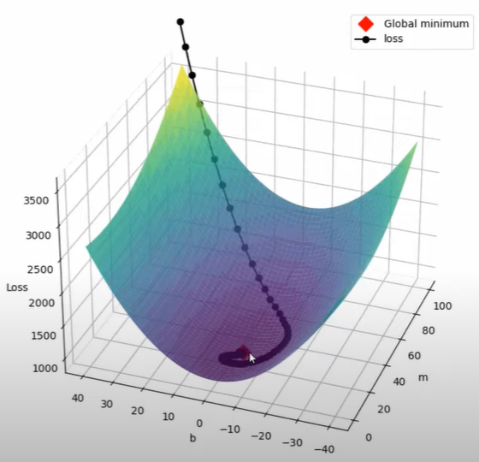
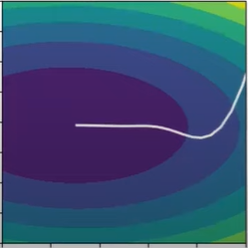
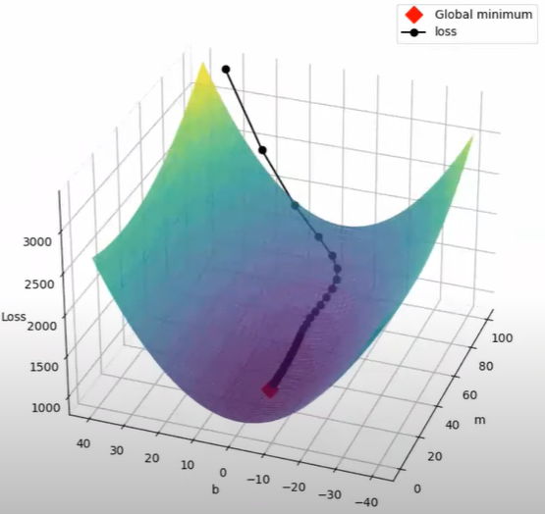
Adam

Slide 26
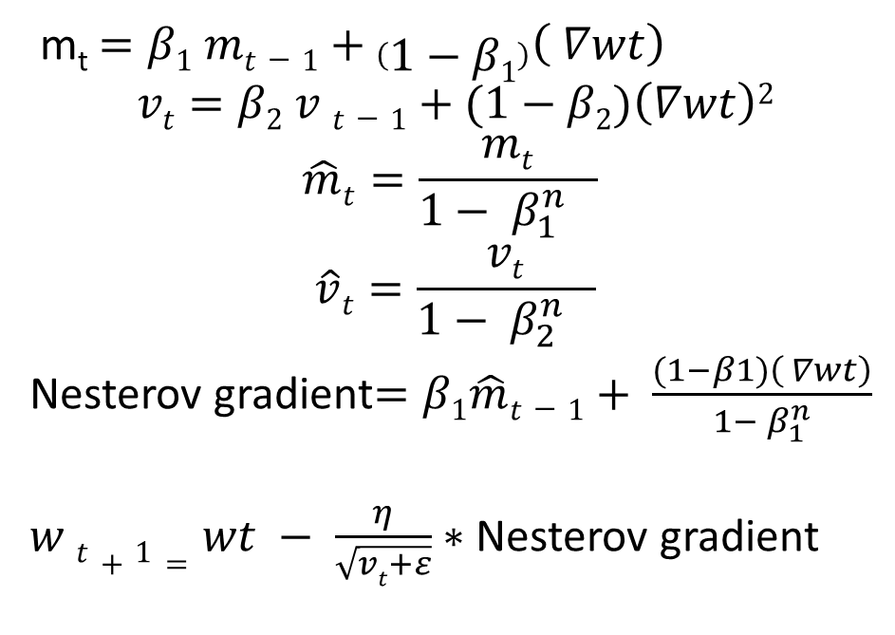
NAdam
Extension for enhancing Adam with improved gradients (NAG).
Weight updated:
m_{t}$=β1 mt−1+\left(1−β1\right)\left( ∇wt\right)$
$$vt=β2 v t−1+(1−β2)\left(∇wt\right)2$$
$$\hat{m}t=\frac{mt}{1− β_{1}^{n} }$$
$$\hat{v}t=\frac{vt}{1− β_{2}^{n} }$$
Nesterov gradient$=β1\hat{m}t−1+ \frac{(1−β1)\left( ∇wt\right)}{1− β_{1}^{n}}$
$w t+1=wt − \frac{η}{\sqrt{vt+ε}}∗$Nesterov gradient

Slide 27
Nadam
Convergence quality is good here.
Speed of training fast.
In the Adam algorithm, NADAM integrates Nesterov momentum, which is at times superior to vanilla momentum.

Slide 28
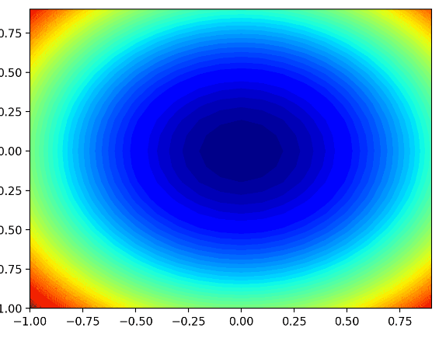
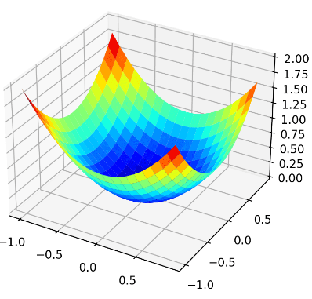

Nadam
Visualization:

Slide 29
References
Yoshua Bengio, Nicolas Boulanger-Lewandowski, and Razvan Pascanu. Advances in Optimizing Recurrent Networks. 2012.
Yoshua Bengio, Jérôme Louradour, Ronan Collobert, and Jason Weston. Curriculum learning.Proceedings of the 26th annual international conference on machine learning, pages 41–48, 2009.
C. Darken, J. Chang, and J. Moody. Learning rate schedules for faster stochastic gradient search. Neural Networks for Signal Processing II Proceedings of the 1992 IEEE Workshop, (September):1–11, 1992.
Richard S. Sutton. Two problems with backpropagation and other steepest-descent learning procedures for networks, 1986.
Diederik P. Kingma and Jimmy Lei Ba. Adam: a Method for Stochastic Optimization. International Conference on Learning Representations, pages 1–13, 2015.
Loshchilov, I. and Hutter, F., 2017. Decoupled weight decay regularization. arXiv preprint arXiv:1711.05101.

Slide 30
Thank You

